Slide 1


Four programs using SELF-e that engage and inspire writers of all ages
SCLA Panel Discussion
Notes:
NOTE:
To change the image on this slide, select the picture and delete it. Then click the Pictures icon in the placeholder to insert your own image.

Slide 2



Presentation Description:
Ever want to organize a maker program and been told there’s no space or funding to do it? SELF-e is a self-publishing platform provided to all public libraries at no cost and is known for its ease of use. Panelists from the State Library and public libraries discuss how it has been used successfully in various contexts by people of all ages. Panelists will describe programs they have offered to their patrons that resulted in the publishing of works in Indie SC using SELF-e.
These programs, when combined with SELF-e incorporate literacy, community engagement, and skill development, making published works available to a wide audience of readers in the Indie SC collection.

Slide 3
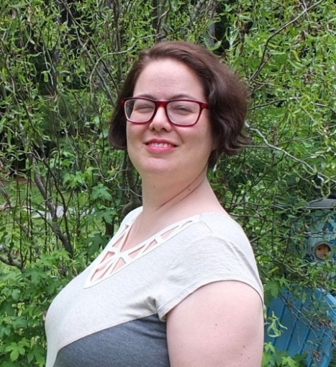
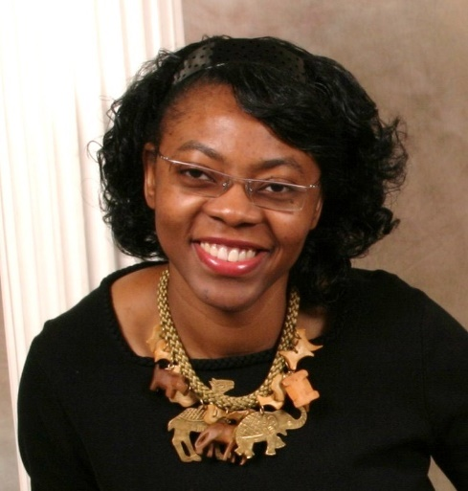
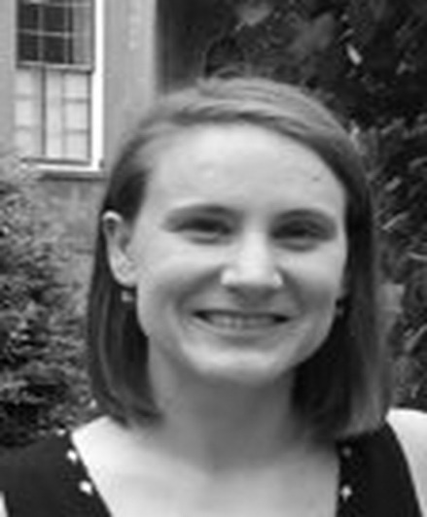
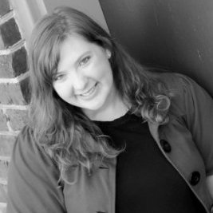
Meet the Panelists
Tina Chenoweth, Former Teen Librarian at Dorchester County Library and current St. Stephen Branch Manager in Berkeley County; tina.chenoweth@berkeleycountysc.gov
(843) 567-4862
Shiela Keaise, Colleton County Children’s Librarian and SC Indie Author; skeaise@colletoncounty.org
(843) 549-5621, ext. 4
Kristen Simensen, Calhoun County Library Director and lead on the LSTA funded SC New Writers grant; ksimensen@calhouncountylibrary.org (803) 874-3389
Katie Simmons, South Carolina State Library User Experience Designer; ksimmons@statelibrary.sc.gov 803-734-5831

Slide 4

Tina Chenoweth – St. Stephen Branch Manager
Tina coordinated and lead a group of youth called the Board of Bookworms (B.O.B.) to write and publish Turn the Page; Hear Our Voices: Six Word Memoirs by the Teens of Board of Bookworms (B.O.B.)
What began as a poetry slam evolved into the Six Word Memoirs.
The B.O.B teens also created graphic novels and a quarterly literary magazine called Bookworm.
The publishing of Bookworm: The Magazine for Teens by Teens was achieved through a partnership with the teens and the Rollings School of the Arts in Dorchester County.
Volume 1, 2016 is in Indie SC in the Literary Magazines collection.

Slide 5

Shiela Keaise, Colleton County Children’s Librarian and SC Indie Author
Shiela Martina Keaise has always had a passion for children and has written 10 children’s books with more pending publication.
The Illustrate-A-Book (IAB) project, included in the Indie SC collection, is a curated collection of children’s books that include illustrations by Colleton County Youth. Currently five of the ten IAB books are in Indie SC.
One book in particular, Jack’s Beanstalk Medley includes a foreword by Representative Bakari Sellers.
Shiela partnered with schools to hold an illustration contest to get the Colleton County youth, ages 7-18 published. There are 130 Colleton youth who are now published illustrators as a result of judging conducted by local citizens.

Slide 6
Kristen Simensen, Calhoun County Library Director
Kristen Simensen has been the lead on the LSTA New Writers grant, working with the South Carolina State Library (SCSL) and county libraries to secure the funding, promote the potential of SELF-e, and roll-out the product to our citizens.
Kristen arranged the assistance of C. Hope Clark as a speaker and advisor for new authors and writing groups throughout SC while working with the SCSL to host the New Writers Partnership which supports writers and literacy.
In addition, Kristen coordinated Hope’s speaking schedules, as well as a multitude of grant funding details and reporting requirements.

Slide 7
Katie Simmons, South Carolina State Library User Experience Designer
Katie Simmons designed the SCSL SELF-e portal: http://www.statelibrary.sc.gov/self-e, conducted video interviews with C. Hope Clark, and worked within Hope’s speaking schedule to get the “Writers Resources” for traditional and self-published writers on the website.
The video topics presented by Ms. Clark include:
Habits of Successful Writers
Plot Development
Character Development
Editing
Publishing
Marketing
The SELF-e portal was designed to provide a landing page for writers to find a list of writing groups, annual literary events, state-wide publishers, Ms. Clark’s videos, and links to helpful tools and websites.

Slide 8

Additional Information
For additional information about SELF-e and the Indie SC collection contact:
Patricia Sinclair
Electronic Resources Coordinator
SC State Library
psinclair@statelibrary.sc.gov
803-734-8851

